Slide 1
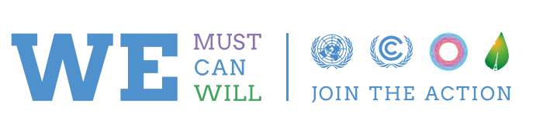



Local Government Climate Roadmap
Paris Dialogues
COP21 Outcomes
of Local and Subnational Governments
As of 9 February 2016

Slide 2

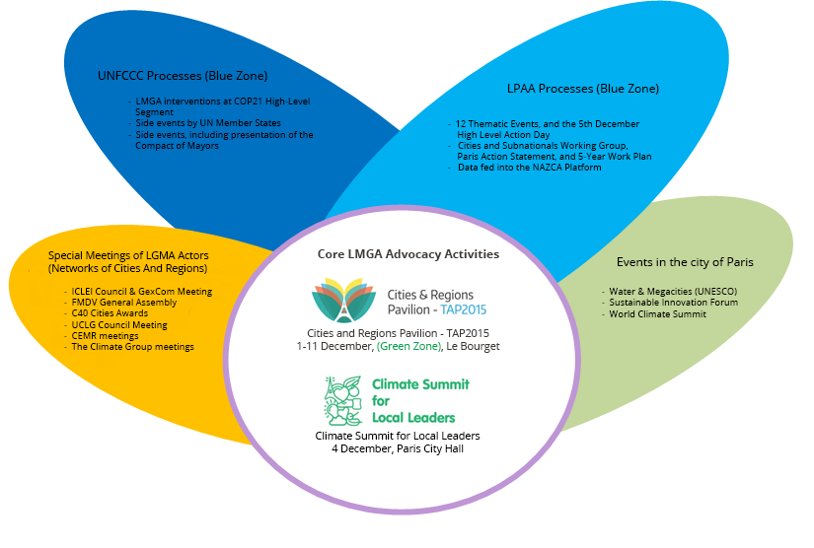
Local Government Climate Roadmap Paris Dialogues
SCHEMATIC OVERVIEW
COP21/CMP11 Agenda of Local and Subnational Governments

Slide 3
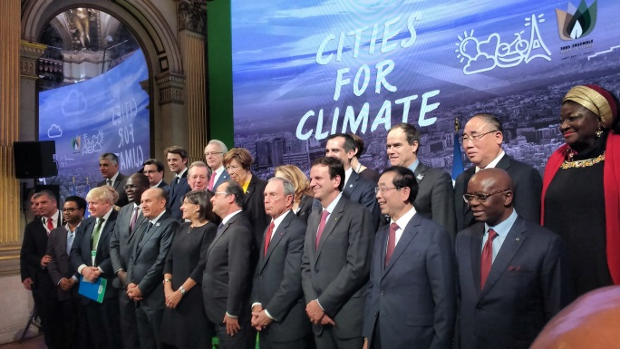
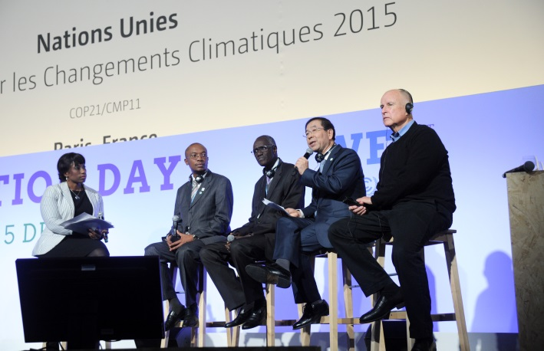
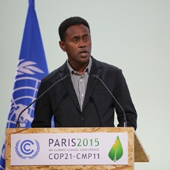
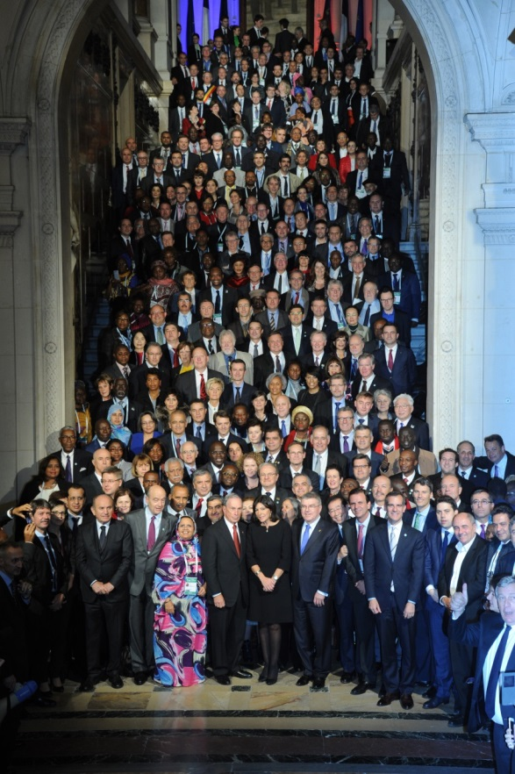
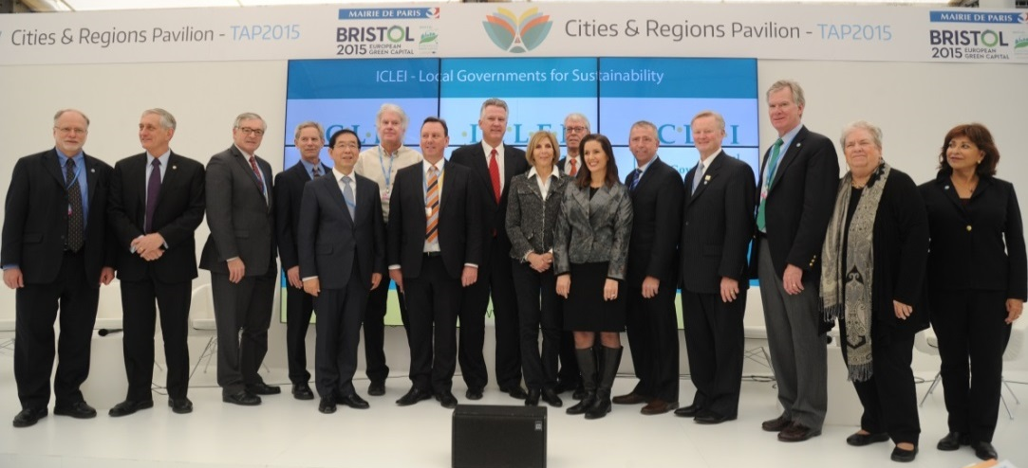
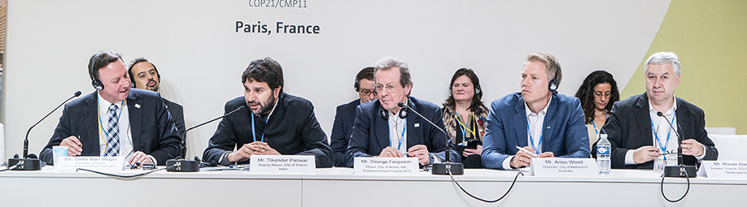

Slide 4
Layman´s Guide to Paris Climate Package
Paris Climate Package
Paris Agreement
(Annex of Dec.1/CP21)
COP21 Decision (Dec.1/CP21)
=
+
Overview
Defines the course of future global climate action
Open for signature on 22 April 2016 for a period of one year
Has to be ratified by national parliaments, legislative bodies or executive orders by Heads of States
Enters into force, upon ratification by at least 55 Parties & representing 55% of global GHG emissions
In effect immediately after Paris
Lays the foundation and clarifies implementation details of the Agreement as well as the actions/processes to be implemented before 2020
Document Structure
Preamble with 16 Paragraphs and 29 Articles
Does not contain any Annex to classify countries or to list commitments
Preamble with 15 Paragraphs
140 paragraphs in 6 Sections (Adoption, INDCs, Decisions for Agreement, Pre2020 Ambition, Non-Party Stakeholders (NPS), Administrative)
Relevance to Local and Subnational Governments
Preamble para.15, stronger actions by Non-Party Stakeholders (NPS), including cities & other subnational authorities
Para.74.d&g (Paris Committee on Capacity Building and its 2016-2020 Workplan at subnational level)
Engagement in pre-2020 Action as NPS, in paragraphs;
  107 (voluntary cancellation of KP units),
  110 and 125 (Technical Examination Process (TEPs) Mitigation and Adaptation, respectively)
  117 (Lima-Paris Action Agenda), 118 (NAZCA), 119 (Parties to work w/ NPS), 120 (NPS in TEPs)
  121.d (NPS in High Level event), 122.b (Champions engaging w/ NPS)
  134-137 (Non-Party Stakeholders)
Preamble para.15 recognizes importance of engagement of all levels of governments
References to local and subnational levels in Art. 7.2 (adaptation) and Art.11.2 (capacity building), communities in Art. 8.4.h (loss and damage)

Slide 5
Layman´s Guide to Paris Climate Package
Civil Society
Private Sector
Non-Party
Stakeholders*
* Preamble para.15
Dec.1/CP21
=
Financial Institutions
Cities and other Subnational Authorities
Local communities and indigenous people
Local and Subnational governments
(i.e. governmental stakeholders as per para.7 of Dec.1/CP16 in 2010)
Non-State
Actors
Non-Party Stakeholders
=
+

Slide 6
From Bali/2007 to Paris/2015
Achievements of global climate advocacy
of Local and Subnational Governments
Local and subnational governments as “ governmental stakeholders“
(Para.7 of Dec.1/CP16, in Cancun in 2010)
2. Role of cities and subnational authorities in raising pre2020 ambition
(Para.5b of Dec.1/CP19, in Warsaw in 2013)
3. Engaging with all levels of governments, as well as local, subnational and community level in capacity building, adaptation and loss and damage
(Paris Agreement preamble para.15, 7.2, 11.2, 8.4.h + COP21 Decision on Non-Party Stakeholders)
√
Recognize
Ministerial-Mayoral Dialogues (COP16-2010-Cancun, COP19-2013-Warsaw) and High Level Action Days (COP20-2014-Lima, COP21-2015-Paris)
ADP Workstream-2 Technical Examination Process on Urban Environment
Compact of Mayors, Compact of States and Regions, Covenant of Mayors etc.
Special UNFCCC badges for Political Leaders of Local and Subnational Governments
Lima-Paris Action Agenda (LPAA) Declarations, 5-Year Vision and NAZCA Platform, including carbonn Climate Registry as data partner
Friends of Cities at the UNFCCC, increased number of local and subnational leaders in the national delegations of both Annex-I and Non-Annex-I Parties
Workplan of Paris Committtee on Capacity Building (para. 73.d/g of Dec. 1/CP21)
~ 50% of submitted INDCs in 2015 have a focus on action at local and subnational level
Cities and regions contributing to Green Climate Fund and GEF
Engage
√
√
Empower
New resources (e.g. GEF Integrated Action Programme on Sustainable Cities, Cities Climate Finance Leadership Alliance (CCFLA) , UN Subnational Climate Action Hub)
Transformative Actions Programme (TAP)
2030 SD Agenda; Sendai-Disaster, Addis Ababa-Finance, SDGs (including Goal:11)
NEXT STEP THROUGH PARIS AGREEMENT : RAISE AMBITION AND ACCELERATE ACTION
Notes:
The Local Government Climate Roadmap is an advocacy process that began in 2007. Aimed at voicing local authorities worldwide, it mirrors the launch of the United Nations Climate Change Conference Climate Roadmap, designed for nations, in determining a global action plan towards a post-Kyoto framework on climate change for the period after 2012. Since then, LGs have campaigned, and obtained, referencing to subnational and local governments by national negotiators. The next phase of the process is to secure collaboration with nations, and a financial framework through which local governments’ can fund ambitious climate actions.
The Roadmap engages more than 30 organizations worldwide.

Slide 7
Non-Party Stakeholders
in an Inclusive Paris Climate Package
Background
  1992/UNFCCC and 1997/KP; no vision for a role to anyone other than Parties
  Non-Party intervention: long term taboo on commitments
  COP20 Lima consensus: Door-opener for a Race-to-the-Top
    A new concept : CBDR-RC+inline of different national national circumstances
    No UN level enforcement/compliance mechanism to revise INDCs
  Language in Paris Package; revolutionary compared to UNFCCC/KP but much less innovative and ambitious compared to COP20/2014 ADP Co-Chairs Text – negotiated outcome
Paris Agreement
  No definition or reference to stakeholders, civil society or non-state actors in the Operative paragraphs
  Preamble para.15 – engagement at all levels of government and actors
COP21 Paris Decision
  Preamble para.15: composition of Non-Party stakeholders
  Section:IV– para 117-133: Raising pre2020 ambition by engaging Non-Party Stakeholders; in TEMs, reporting through NAZCA, Lima-Paris Action Agenda, work with COP Presidency Champions
  Section: V-para134-137: broader role, specific provisions for local communities and indigenous, and the only para referring to carbon pricing
Paris Pledge for Action – a global mobilization of Non-Party Stakeholders in support of Paris Agreement
The road ahead
  Governance among: Institutions (UN SG Office – UNFCCC – UNEP) and Processes (22 April – 4/6 May UN Implementation Summit / SDGs / HABITATIII)
  Synergy between UNFCCC processes and LPAA Outcomes
  Role and performance of COP Presidency Champions
  Climate Chance – Climate Actors World Summit, Nantes, September 2016

Slide 8

Agenda of Local and Subnational Governments
at 2nd UN Environment Assembly (UNEA-2)
As of 9 February 2016

Slide 9

Background
UNEP Decision Making Process
    1972-2012: Governing Council with limited membership (80 countries)
    The first UN body HQ hosted in the Global South and Africa
    Regional outreach (not at the national level)
    Ministerial (Environment) Sessions: every 2 years since 2000
    Technical work; Committee of the Permanent Representatives in Nairobi
    Rio+20 outcomes:
      UNEP as the environmental authority of the UN
      Universal membership
      No additional structural change within the UN system
      Global Environmental Outlook-5 for Local Governments: Joint ICLEI-UNEP Publication
    2013:
      first universal UNEP Governing Council; 100+ countries
    2014:
      First UN Environment Assembly (UNEA)
      Challenges;
        Complexities in decision making with new comers, legal and institutional restructuring
        Capacity to influence other Ministerial tracks – environmental dimension of post2015
        Stakeholder engagement – the only pending agenda not resolved
Stakeholder Engagement
  Limited to NGOs with a global and regional outreach
  Follows the spirit of Agenda 21 (9 Major Groups) and Regional Engagement
  Major Groups and Stakeholders Facilitating Committee and Global Forum of Major Groups and Stakeholders prior to offical OECPR and UNEA sessions
  Local Authorities Major Group : ICLEI and nrg4sd Focal Points, ITDP and Practical Action other members
  Nrgd4sd: Co-Chair of MGFC since 2016

Slide 10
Agenda at UNEA-2
To be held on 23-27 May 2016 in Nairobi
26-27 May: High Level Session with Ministers of Environment and Mayors
Prep Work: Open Ended Working Group of Committee of the Permanent Representatives (15-19 Feb)
Last session under the leadership of Achim Steiner as the Executive Director
UNEA-3 in 2017 with new ED and every odd-year onwards
Key challenges
  The vision and style of the expected new Executive Director
  Role of UNEP in the implementation of Paris Climate Agreement and SDGs, relations with UNFCCC, UNEP at CCFLA Secretariat, H3-PU8, CCAC and UN Subnational Climate Action Hub within the context of HABITATIII ?
    Resolving the stakeholder engagement policy
      Accreditation of national organizations
      Expanding the Major Group Structure The first UN body HQ hosted in the Global South and Africa
Mayors and Subnational Leaders Track
  Suggested by ICLEI in 2013 at the first universal Governing Council to be convened at UNEA-2 for the first time as a means of SDG/climate follow-up, preparation to HABITATIII, supporting UNEP-UNHABITAT Bilaterl partnership
  Further consultations in 2014-UNEA1 & 2015 ICLEI World Congress, HABITATIII-PrepCom2, UN SD Summit 2015 – Call for Joint Action, COP21 and ICLEI-UNEP MoU
  Suggested title: HIGH LEVEL DIALOGUE ON MULTILEVEL PARTNERSHIPS AT UNEA-2 - “Raising Ambition and Accelerate Action on Sustainable Development in Urban World of 2030”
  Format:
    Closed/special sessions of Mayors and Subnational Leaders with UNEP leadership and Ministers – date -tbc
    Speakers in numerous session of Sustainable Innovation Expo on 25 May Wednesday
    Interventions at High Level Segment, side events hosted by LAMG Members and other partners
    Programme development and coordination of Mayors and Subnational leaders to be coordinated by ICLEI on behalf of and with GTF, taking into account agenda in May: UNSG Climate Action Summit in Washington DC, HABITATIII Hearings in NYC, UNFCCC Bonn Climate Conference, World Humanitarian Summit etc
    Further consultations at OECPR on 14-19 February

